Slide 1
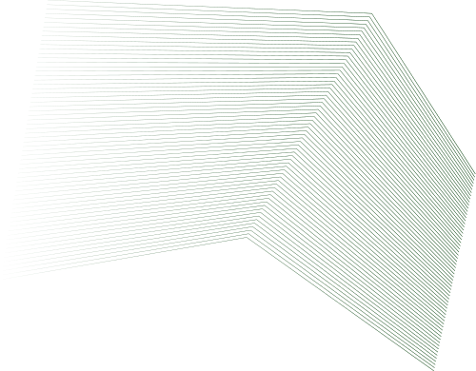
Fundamentals of Computer Design
Malcom Chiaji SCT212-0063/2021

Slide 2
Introduction
It has been 60 years since creation of the first general purpuse computer and computers have improved rapidly ever since.
A personal computer today, costing less than $500, surpasses the performance of a $1 million computer from 1985.
In the first 25 years of their existence, computers improved at a rate of 25% per year but the rate increased to 35% per year in the late 1970 due to the technology of the microprocessor and kept increasing since then.
The main factors favoring these advancements were;
Reduction of Assembly Language: No need for strict object-code compatibility.
Standardized OS: UNIX and Linux made new architectures more viable.
RISC Architectures: Simplified instruction sets enabled better instruction-level parallelism (ILP) and cache optimization
However, performance growth slowed down to about 20% per year since 2002 due to;
Power limitations in air-cooled chips.
Limited instruction-level parallelism.
Memory latency issues.
Post 2002, there was a shift from Instruction Level Programming to Thread Level Parallelism and Data Level Parallelism

Slide 3
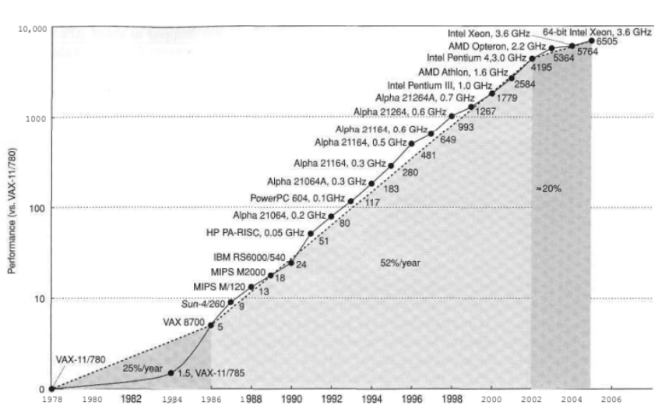

Slide 4
Classes of Computers
Mainframes (1960s): Large, centralized computers used for business and scientific computing.
Minicomputers (1970s): Smaller systems enabling multi-user interactive computing.
Supercomputers (1970s): High-end scientific computing computers.
Desktop Computers (1980s–Present):Performance-focused, optimizing price-performance.First to adopt latest microprocessor advancements.
Embedded Computers (2000s–Present):Found in consumer electronics, cars, appliances.Focus on low cost, low power, and application-specific performance.Real-time execution is crucial in many applications.Includes devices ranging from 8-bit microcontrollers to high-end processors for gaming and networking.

Slide 5
Defining computer Architecture
Entails determining important attributes for a new computer then creating a design that maximizes performance while staying within cost, power, and availability constraints.
Its key aspects include;
• Instruction Set Architecture (ISA): Refers to the interface between hardware and software.
• Organization: How components like CPU, memory, and buses interact,
• Hardware Implementation: Physical design, including power and thermal constraints.
ISA cn be categorized by;
-Class of ISA:
General-purpose register architectures dominate today.
Two main types are:
Register-memory allows direct memory access in most instructions.
Load-store requires separate load/store instructions for memory access.
-Memory Addressing:
• Most modern systems use byte addressing.
• Some architectures enforce alignment for memory access efficiency.
-Addressing Modes:
• Defines how memory addresses are computed.
• MIPS has three modes: Register, Immediate, and Displacement.
• x86 supports additional complex addressing modes.
Types & Sizes of Operands:
• Typical operand sizes:
• Floating-point operations follow IEEE 754 standard.
Operations:
• Categorized into data transfer, arithmetic, logic, control, and floating-point operations.
• MIPS follows a simplified RISC model, while x86 has a larger and more complex instruction set.
Control Flow Instructions:
• Includes branches, jumps, and procedure calls.
• MIPS uses register-based branching, while x86 relies on condition codes.
• Instruction Encoding:
• Fixed-length simplifies decoding but increases program size.
• Variable-length saves space but complicates instruction decoding.

Slide 6
-Memory Addressing:
• Most modern systems use byte addressing.
• Some architectures enforce alignment for memory access efficiency.
-Addressing Modes:
• Defines how memory addresses are computed.
• MIPS has three modes: Register, Immediate, and Displacement.
• x86 supports additional complex addressing modes.
Types & Sizes of Operands:
• Floating-point operations follow IEEE 754 standard.
Operations:
• Categorized into data transfer, arithmetic, logic, control, and floating-point operations.
• MIPS follows a simplified RISC model, while x86 has a larger and more complex instruction set.
Control Flow Instructions:
• Includes branches, jumps, and procedure calls.
• MIPS uses register-based branching, while x86 relies on condition codes.
• Instruction Encoding:
• Fixed-length simplifies decoding but increases program size.
• Variable-length saves space but complicates instruction decoding.

Slide 7
Trends in Technology
There are four main implementation technologies;
Integrated Circuit Logic technology: Transistor density grows 35% per year.Combined with increased die size, transistor count grows 40-55% per year.
SemiconductorDRAM Memory: Capacity doubles every two years having about 40% annual growth.
Magnetic Disks: Density grew 60% per year (pre-2000) but slowed to 30% per year.
Networking: Ethernet bandwidth jumped from 10 Mbps (1978) to 10 Gbps (2003).
Performance trends: Bandwith over latency
Bandwidth has increased exponentially, but latency improvements are slower.
Memory access speeds have not kept up with CPU improvements.
Wire delays limit chip performance.This is a factor to be accounted for in new architectures

Slide 8
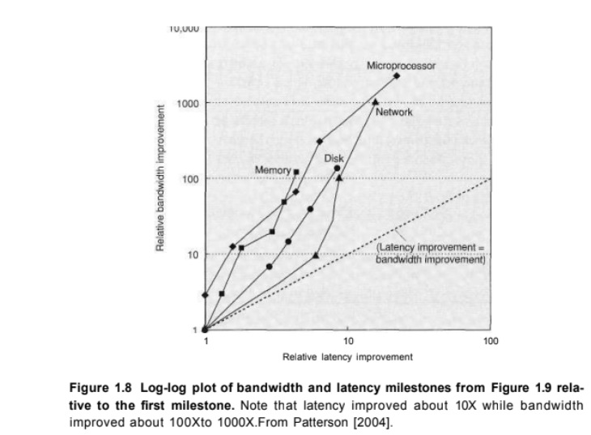

Slide 9
Trends in power in Intergrated Circuits
Power dynamic = 1/2 x Capacitive load x Voltage x Frequency switched
Dynamic power and energy are greatly reduced by lowering the volt-
age, and so voltages have dropped from 5V to just over IV in 20 years.
Power is now the major limitation to using transistors; in the past it was raw silicon area.
Overheating is also a major problem facing intergrated circuits
Multi core processing and dynamic voltage and frequency scaling are mitigation techniques for power limitations

Slide 10

Trends in Cost
Factors influencing cost include;
Learning curve: Manufacturing costs decrease over time
Volume: High production volumes lower costs
Commodities: Are products that are sold by multiple vendors in large volumes
and are essentially identical.This causes high competition and reduces gap between cost and selling price hence low product costs
Cost per functional die depends on wafer cost, yield, and die area.

